Slide 1
Chapter 5: Mass, Bernoulli, and Energy Equations
Chao-Lung Ting
Department of Engineering Science and Ocean Engineering
National Taiwan University
Fall 2014

Slide 2
Introduction
This chapter deals with 3 equations commonly used in fluid mechanics
  The mass equation is an expression of the conservation of mass principle.
  The Bernoulli equation is concerned with the conservation of kinetic, potential, and flow energies of a fluid stream and their conversion to each other.
  The energy equation is a statement of the conservation of energy principle. (mechanical energy balance)

Slide 3
Objectives
After completing this chapter, you should be able to
  Apply the mass equation to balance the incoming and outgoing flow rates in a flow system.
  Recognize various forms of mechanical energy, and work with energy conversion efficiencies.
  Understand the use and limitations of the Bernoulli equation, and apply it to solve a variety of fluid flow problems.
  Work with the energy equation expressed in terms of heads, and use it to determine turbine power output and pumping power requirements.

Slide 4
Conservation of Mass
Conservation of mass principle is one of the most fundamental principles in nature.
Mass, like energy, is a conserved property, and it cannot be created or destroyed during a process. (However, mass m and energy E can be converted to each other according to the well-known formula proposed by Albert Einstein (1879–1955), )
For closed systems mass conservation is implicit since the mass of the system remains constant during a process.
For control volumes, mass can cross the boundaries which means that we must keep track of the amount of mass entering and leaving the control volume.

Slide 5
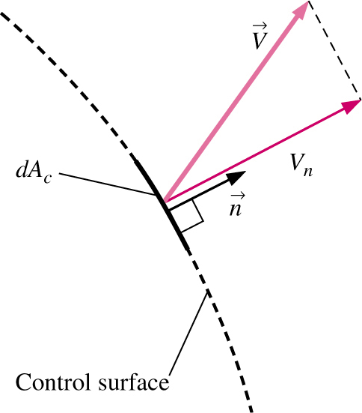

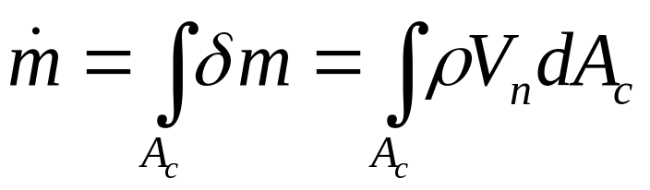
Mass and Volume Flow Rates
The amount of mass flowing through a control surface per unit time is called the mass flow rate and is denoted
The dot over a symbol is used to indicate time rate of change.
Flow rate across the entire cross-sectional area of a pipe or duct is obtained by integration
While this expression for is exact, it is not always convenient for engineering analyses. (Express mass flow rate in terms of average values )

Slide 6
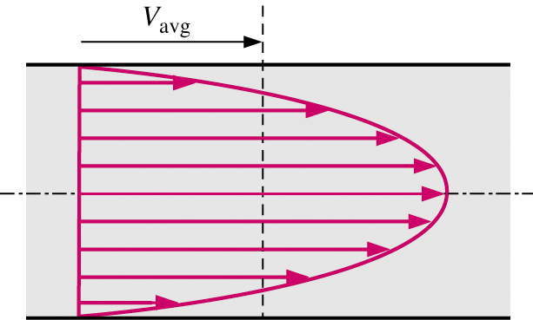
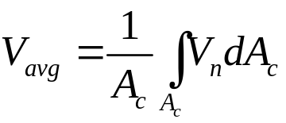


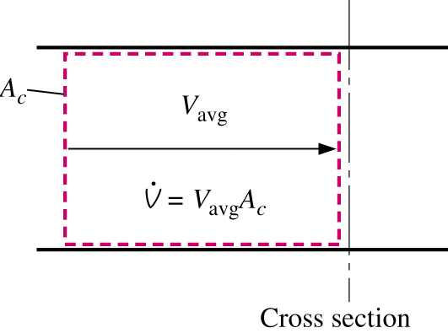
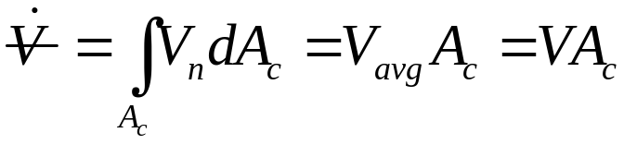

Average Velocity and Volume Flow Rate
Integral in can be replaced with average values of ρ and V_{n}
For many flows variation of ρ is very small:
Volume flow rate is given by
Note: many textbooks use Q instead of for volume flow rate.
Mass and volume flow rates are related by

Slide 7
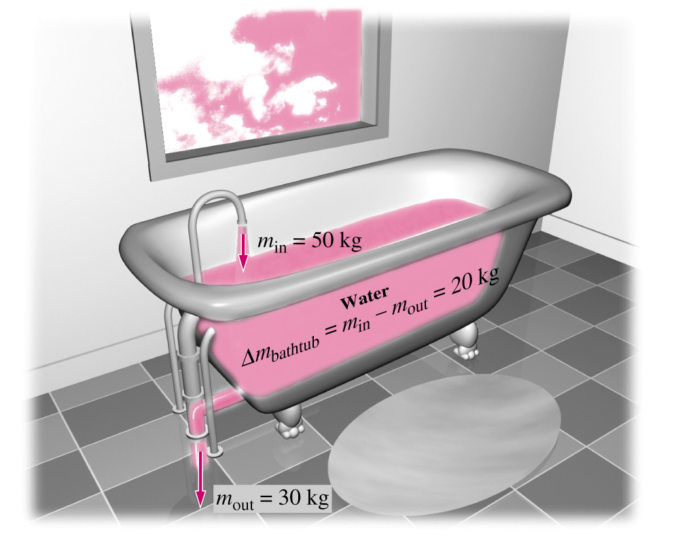
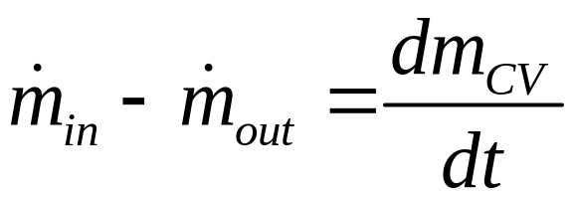


Conservation of Mass Principle
The conservation of mass principle can be expressed as
Where and are the total rates of mass flow into and out of the CV, and dm_{CV}/dt is the rate of change of mass within the CV.

Slide 8
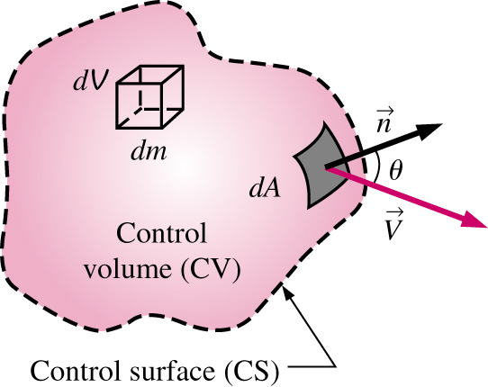
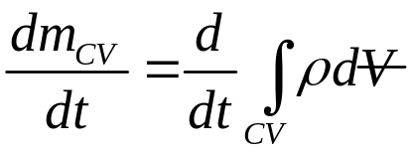
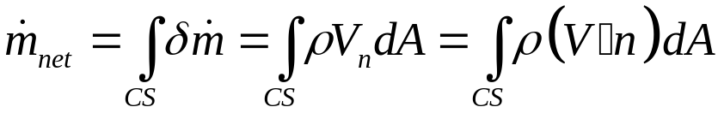
Conservation of Mass Principle
For CV of arbitrary shape,
  rate of change of mass within the CV
  net mass flow rate
•
Outflow ( θ < 90) positive
Inflow (θ >90) negative

Slide 9
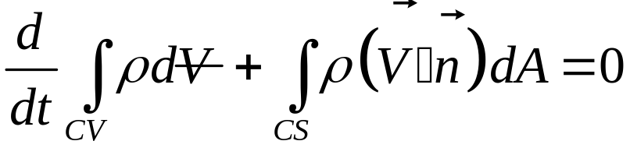
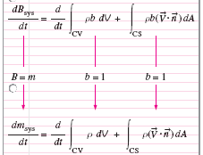
Conservation of Mass Principle
Therefore, general conservation of mass for a fixed CV is:
•
Using RTT

Slide 10
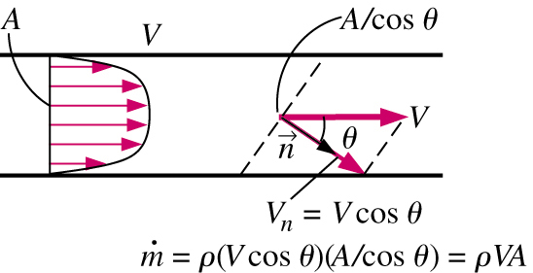



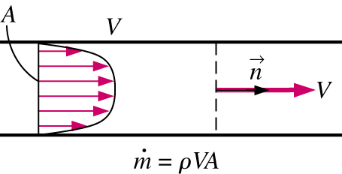
Conservation of Mass Principle
Change the surface integral into summation, then we can get the following expression:
or
For a moving CV, just change V to V_{r} in the equation where V_{r} equal to
Proper choice of a control volume

Slide 11
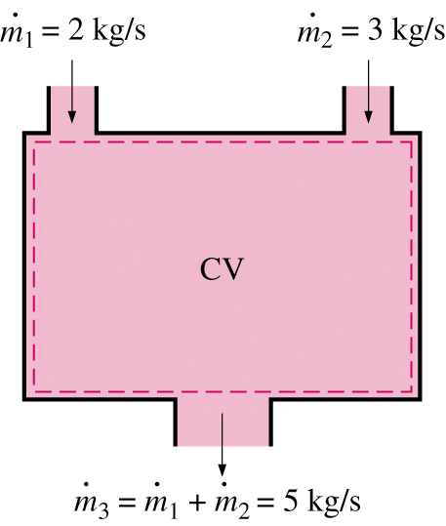
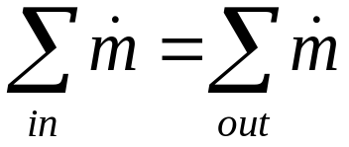
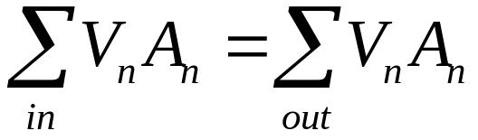
Steady—Flow Processes
For steady flow, the total amount of mass contained in CV is constant.
Total amount of mass entering must be equal to total amount of mass leaving
for single-stream steady-flow systems,
For incompressible flows (ρ = constant),

Slide 12


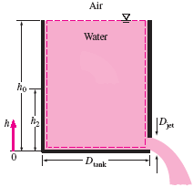





EXAMPLE: Discharge of Water from a Tank
A 4-ft-high, 3-ft-diameter cylindrical water tank whose top is open to the atmosphere is initially filled with water. Now the discharge plug near the bottom of the tank is pulled out, and a water jet whose diameter is 0.5 in streams out. The average velocity of the jet is given by
, where h is the height of water in the tank measured from the center of the hole (a variable) and g is the gravitational acceleration. Determine how long it will take for the water level in the tank to drop to 2 ft from the bottom.

Slide 13
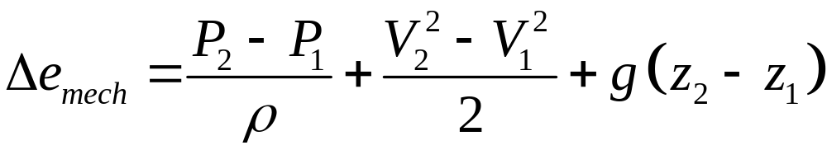
Mechanical Energy
Mechanical energy can be defined as the form of energy that can be converted to mechanical work completely and directly by an ideal mechanical device such as an ideal turbine.
Flow P/ρ, kinetic V²/2, and potential gz energy are the forms of mechanical energy e_{mech}= P/ρ + V²/2 + gz
Mechanical energy change of a fluid during incompressible flow becomes
In the absence of loses, Δe_{mech} represents the work supplied to the fluid (Δe_{mech}>0) or extracted from the fluid (Δe_{mech}<0).

Slide 14
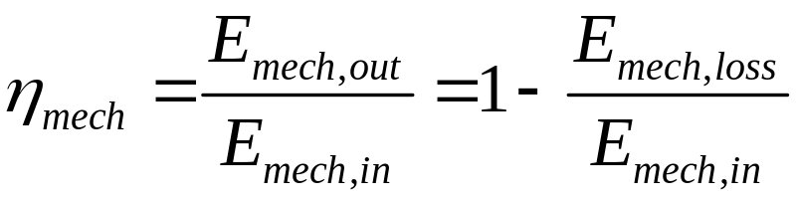
Efficiency
Transfer of e_{mech} is usually accomplished by a rotating shaft: shaft work
Pump, fan, propulsion: receives shaft work (e.g., from an electric motor) and transfers it to the fluid as mechanical energy
Turbine: converts e_{mech} of a fluid to shaft work.
In the absence of irreversibilities (e.g., friction), mechanical efficiency of a device or process can be defined as
If η_{mech} < 100%, losses have occurred during conversion.

Slide 15
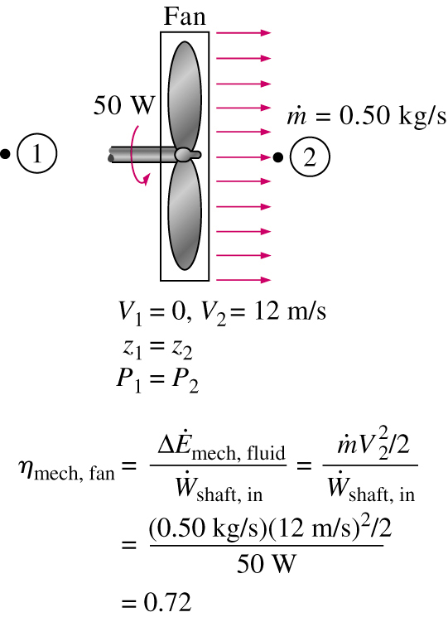
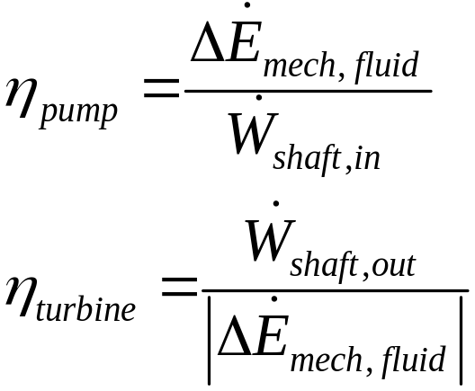
Pump and Turbine Efficiencies
In fluid systems, we are usually interested in increasing the pressure, velocity, and/or elevation of a fluid.
In these cases, efficiency is better defined as the ratio of (supplied or extracted work) vs. rate of increase in mechanical energy

Slide 16

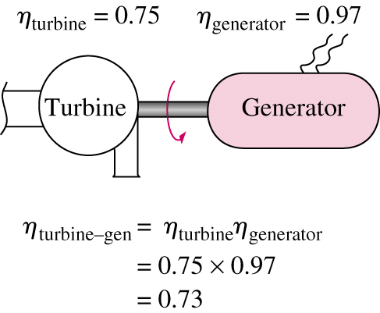



Pump and Turbine Efficiencies
Overall efficiency must include motor or generator efficiency.

Slide 17
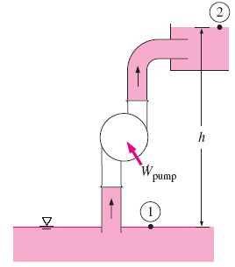
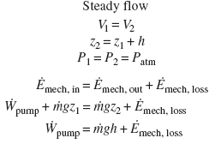
Mechanical energy balance.

Slide 18
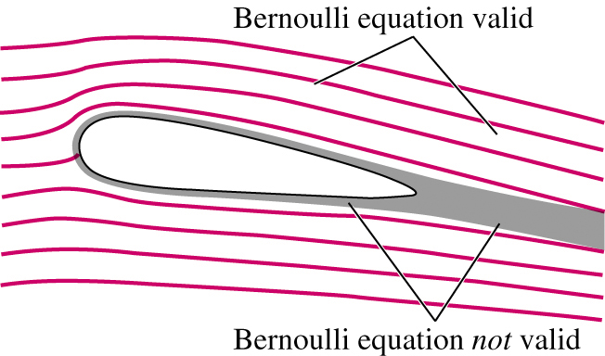
The Bernoulli Equation
The Bernoulli equation is an approximate relation between pressure, velocity, and elevation and is valid in regions of steady, incompressible flow where net frictional forces are negligible.
Equation is useful in flow regions outside of boundary layers and wakes, where the fluid motion is governed by the combined effects of pressure and gravity forces.

Slide 19
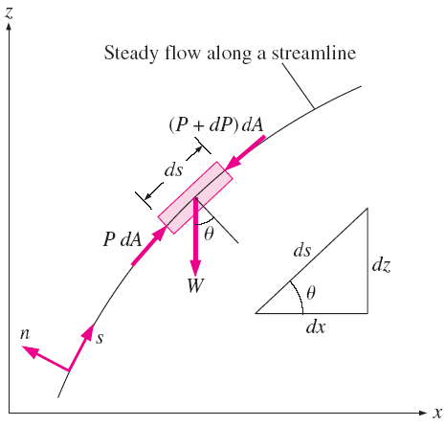
Acceleration of a Fluid Particle
Describe the motion of a particle in terms of its distance s along a streamline together with the radius of curvature along the streamline.
The velocity of a particle along a streamline is V = V(s, t) = ds/dt
The acceleration can be decomposed into two components: streamwise acceleration a_{s} along the streamline and normal acceleration a_{n} in the direction normal to the streamline, which is given as a_{n} = V²/R.

Slide 20


Acceleration of a Fluid Particle
Note that streamwise acceleration is due to a change in speed along a streamline, and normal acceleration is due to a change in direction.
The time rate change of velocity is the acceleration
In steady flow, the acceleration in the s direction becomes
(Proof on Blackboard)

Slide 21



Derivation of the Bernoulli Equation
Applying Newton’s second law in the s-direction on a particle moving along a streamline in a steady flow field gives
The force balance in s direction
gives
where
and

Slide 22



Derivation of the Bernoulli Equation
Therefore,
Integrating steady flow along a streamline
Steady, Incompressible flow
⇒
This is the famous Bernoulli equation.

Slide 23
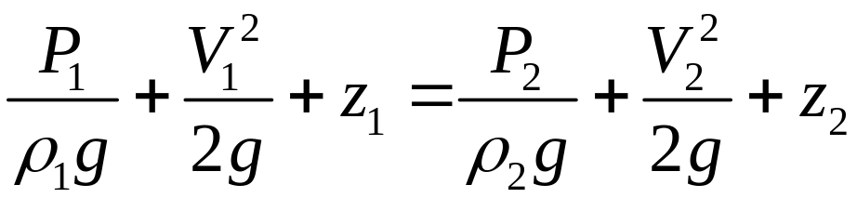
The Bernoulli Equation
Without the consideration of any losses, two points on the same streamline satisfy
where P/ρ as flow energy, V²/2 as kinetic energy, and gz as potential energy, all per unit mass.
The Bernoulli equation can be viewed as an expression of mechanical energy balance
Was first stated in words by the Swiss mathematician Daniel Bernoulli (1700–1782) in a text written in 1738.

Slide 24


The Bernoulli Equation
Force Balance across Streamlines
A force balance in the direction n normal to the streamline for steady, incompressible flow:
For flow along a straight line, R → ∞, then equation becomes
which is an expression for the variation of hydrostatic pressure as same as that in the stationary fluid

Slide 25

The Bernoulli Equation
Bernoulli equation for unsteady, compressible flow is

Slide 26

Static, Dynamic, and Stagnation Pressures
The Bernoulli equation
P is the static pressure; it represents the actual thermodynamic pressure of the fluid. This is the same as the pressure used in thermodynamics and property tables.
ρV²/2 is the dynamic pressure; it represents the pressure rise when the fluid in motion.
ρgz is the hydrostatic pressure, depends on the reference level selected.

Slide 27
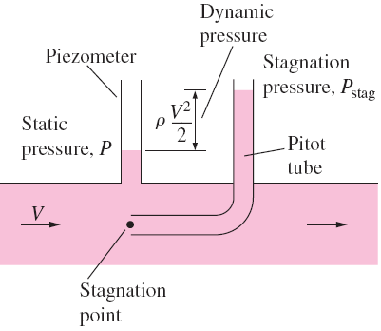


Static, Dynamic, and Stagnation Pressures
The sum of the static, dynamic, and hydrostatic pressures is called the total pressure (a constant along a streamline).
The sum of the static and dynamic pressures is called the stagnation pressure,
The fluid velocity at that location can be calculated from

Slide 28
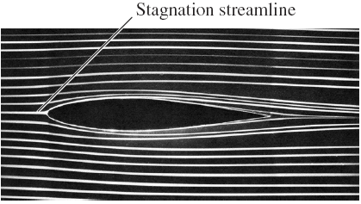
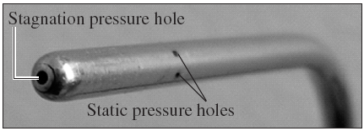
Pitot-static probe
The fluid velocity at that location can be calculated from
A piezometer measures static pressure.

Slide 29
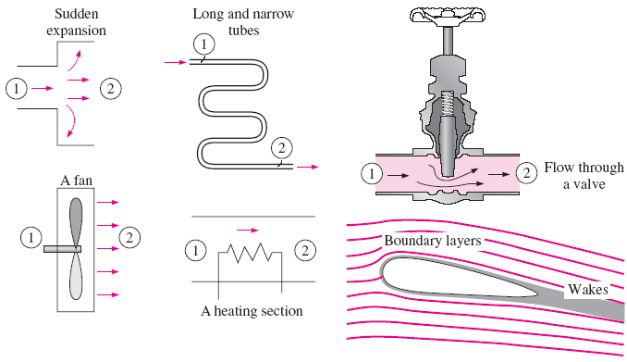
Limitations on the use of the Bernoulli Equation
Steady flow: d/dt = 0, it should not be used during the transient start-up and shut-down periods, or during periods of change in the flow conditions.
Frictionless flow
: The flow conditions described by the right graphs can make the Bernoulli
equation inapplicable.

Slide 30
Limitations on the use of the Bernoulli Equation
No shaft work: w_{pump}=w_{turbine}=0. The Bernoulli equation can still be applied to a flow section prior to or past a machine (with different Bernoulli constants)
Incompressible flow: ρ = constant (liquids and also gases at Mach No. less than about 0.3)
No heat transfer: q_{net,in}=0
Applied along a streamline: The Bernoulli constant C, in general, is different for different streamlines. But when a region of the flow is irrotational, and thus there is no vorticity in the flow field, the value of the constant C remains the same for all streamlines.

Slide 31

HGL and EGL
It is often convenient to plot mechanical energy graphically using heights.
P/ρg is the pressure head; it represents the height of a fluid column that produces the static pressure P.
V²/2g is the velocity head; it represents the elevation needed for a fluid to reach the velocity V during frictionless free fall.
z is the elevation head; it represents the potential energy of the fluid.
H is the total head.

Slide 32
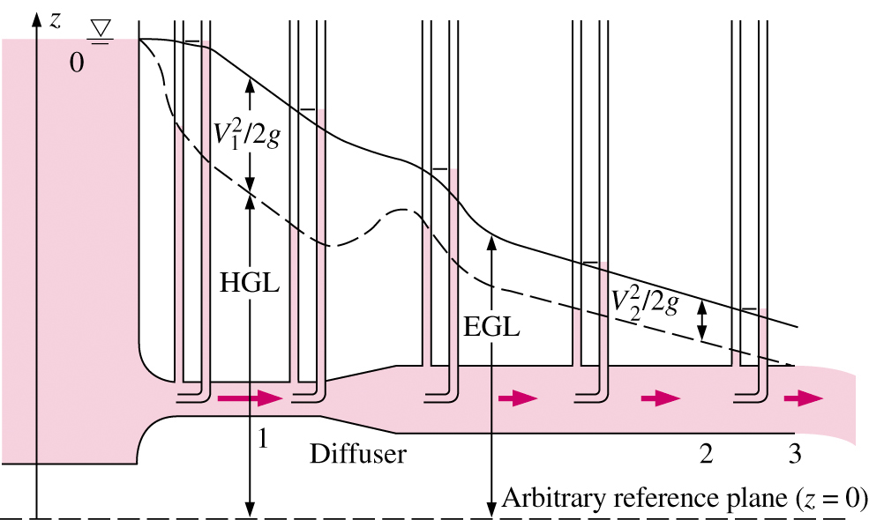
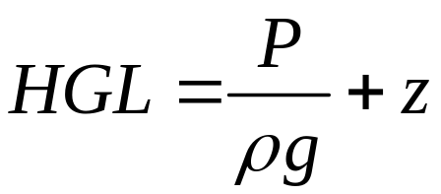
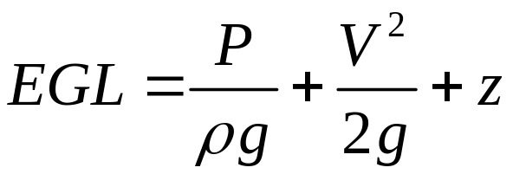
HGL and EGL
Hydraulic Grade Line (HGL)
Energy Grade Line (EGL) (or total head)

Slide 33
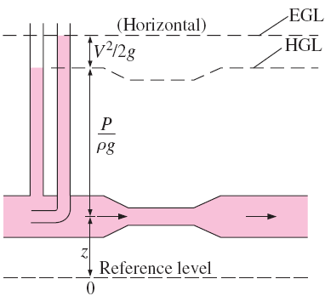
Something to know about HGL and EGL:
For stationary bodies such as reservoirs or lakes, the EGL and HGL coincide with the free surface of the liquid, since the velocity is zero and the static pressure (gage) is zero.
The EGL is always a distance V2/2g above the HGL.
In an idealized Bernoulli-type flow, EGL is horizontal and its height remains constant. This would also be the case for HGL when the flow velocity is constant .
For open-channel flow, the HGL coincides with the free surface of the liquid, and the EGL is a distance V²/2g above the free surface.

Slide 34
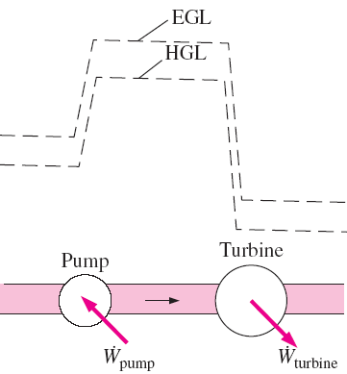
Something to know about HGL and EGL:
At a pipe exit, the pressure head is zero (atmospheric pressure) and thus the HGL coincides with the pipe outlet.
The mechanical energy loss due to frictional effects (conversion to thermal energy) causes the EGL and HGL to slope downward in the direction of flow.
A steep jump occurs in EGL and HGL whenever mechanical energy is added to the fluid. Likewise, a steep drop occurs in EGL and HGL whenever mechanical energy is removed from the fluid.

Slide 35
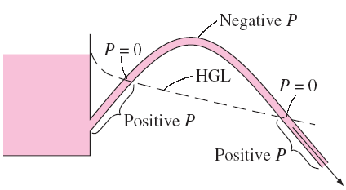
Something to know about HGL and EGL:
The pressure (gage) of a fluid is zero at locations where the HGL intersects the fluid. The pressure in a flow section that lies above the HGL is negative, and the pressure in a section that lies below the HGL is positive.

Slide 36
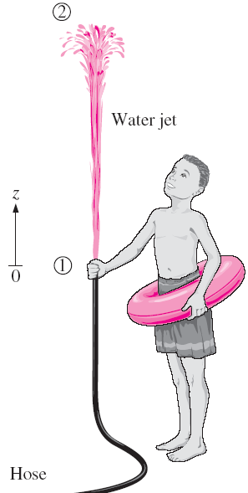




APPLICATIONS OF THE BERNOULLI EQUATION
EXAMPLE: Spraying Water into the Air
Water is flowing from a hose attached to a water main at 400 kPa gage. A child places his thumb to cover most of the hose outlet, causing a thin jet of high-speed water to emerge. If the hose is held upward, what is the maximum height that the jet could achieve?
Assumptions: The flow exiting into the air is steady, incompressible, and irrotational (so that the Bernoulli equation is applicable). The velocity inside the hose is relatively low (V₁ = 0) and we take the hose outlet as the reference level (z₁ = 0). At the top of the water trajectory V₂ = 0, and atmospheric pressure pertains.

Slide 37

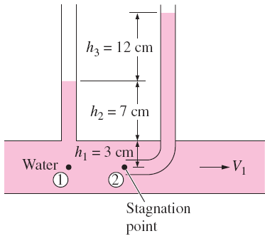



EXAMPLE: Velocity Measurement by a
Pitot Tube
Solution:
A piezometer and a Pitot tube are tapped into a horizontal water pipe to measure static and stagnation pressures. For the indicated water column heights, determine the velocity at the center of the pipe.

Slide 38
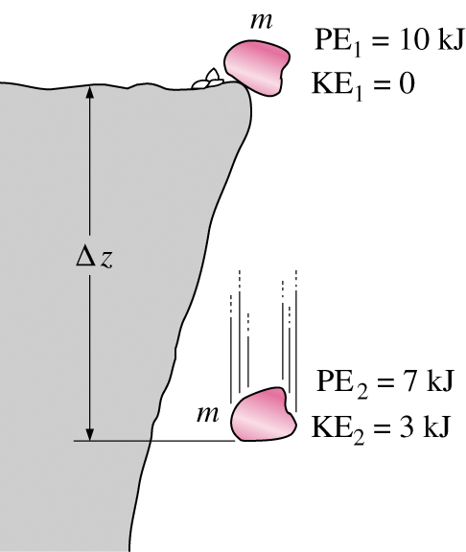

General Energy Equation
One of the most fundamental laws in nature is the 1st law of thermodynamics, which is also known as the conservation of energy principle.
It states that energy can be neither created nor destroyed during a process; it can only change forms
Falling rock, picks up speed as PE is converted to KE.
If air resistance is neglected,
PE + KE = constant
The conservation of energy principle

Slide 39
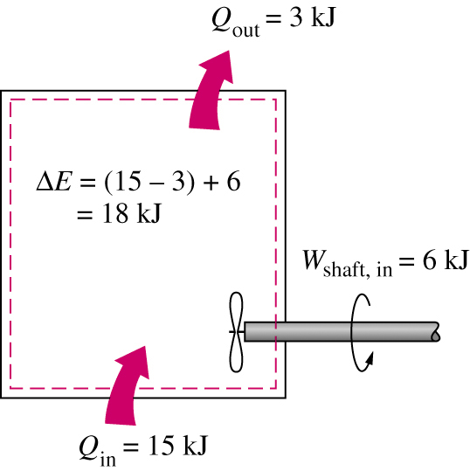
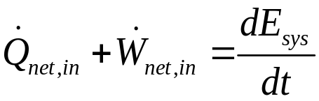




General Energy Equation
The energy content of a closed system can be changed by two mechanisms: heat transfer Q and work transfer W.
Conservation of energy for a closed system can be expressed in rate form as
Net rate of heat transfer to the system:
Net power input to the system:
Where e is total energy per unit mass

Slide 40
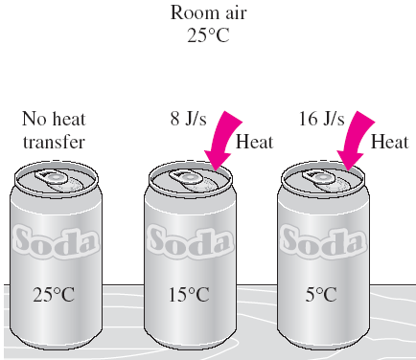
Energy Transfer by Heat, Q
We frequently refer to the sensible and latent forms of internal energy as heat, or thermal energy.
For single phase substances, a change in the thermal energy ⇒
a change in temperature,
The transfer of thermal energy as a result of a temperature difference is called heat transfer.
A process during which there is no heat transfer is called an adiabatic
Process: insulated or same temperature
An adiabatic process ⇔ an isothermal process.

Slide 41
Energy Transfer by Work, W
An energy interaction is work if it is associated with a force acting through a distance.
The time rate of doing work is called power,
A system may involve numerous forms of work, and the total work can be expressed as
Where W_{other} is the work done by other forces such as electric, magnetic, and surface tension, which are insignificant and negligible in this text. Also, W_{viscous}, the work done by viscous forces, are neglected.

Slide 42
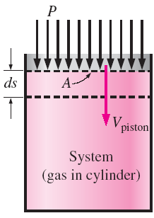



Energy Transfer by Work, W
Shaft Work: The power transmitted via a rotating shaft is proportional to the shaft torque T_{shaft} and is expressed as
Work Done by Pressure Forces: the work done by the pressure forces on the control surface
  The associated power is

Slide 43

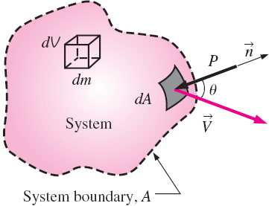


Work Done by Pressure Forces
Consider a system shown in the right graph can deform arbitrarily. What is the power done by pressure?
Why is a negative sign at the right hand side?
The total rate of work done by pressure forces is

Slide 44
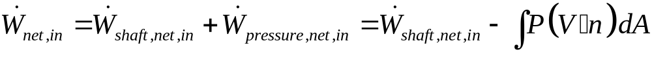

General Energy Equation
Therefore, the net work in can be expressed by
Then the rate form of the conservation of energy relation for a closed system becomes
•

Slide 45
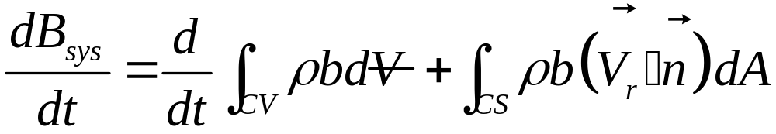
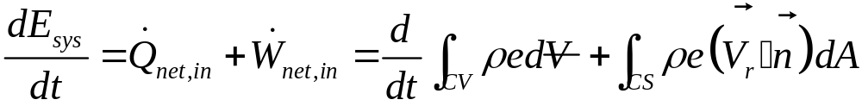

General Energy Equation
Recall general RTT
“Derive” energy equation using B=E and b=e
•
•

Slide 46

General Energy Equation
Moving integral for rate of pressure work to RHS of energy equation results in:
  For fixed control volume, then V_{r} = V
Recall that P/ρ is the flow work, which is the work associated with pushing a fluid into or out of a CV per unit mass.

Slide 47


General Energy Equation
As with the mass equation, practical analysis is often facilitated as averages across inlets and exits
Since e=u+ke+pe = u+V²/2+gz

Slide 48

Energy Analysis of Steady Flows
For steady flow, time rate of change of the energy content of the CV is zero.
This equation states: the net rate of energy transfer to a CV by heat and work transfers during steady flow is equal to the difference between the rates of outgoing and incoming energy flows with mass.

Slide 49


Energy Analysis of Steady Flows
For single-stream devices, mass flow rate is constant.

Slide 50


Energy Analysis of Steady Flows
Rearranging
The left side of Eq. is the mechanical energy input, while the first three terms on the right side represent the mechanical energy output. If the flow is ideal with no loss, the total mechanical energy must be conserved, and the term in parentheses must equal zero.
Any increase in u₂ - u₁ above q_{net in} represents the mechanical energy loss

Slide 51





Energy Analysis of Steady Flows
The steady-flow energy equation on a unit-mass basis can be written as
or
If
Also multiplying the equation by the mass flow rate, then equation becomes

Slide 52




Energy Analysis of Steady Flows
where
In terms of heads, then equation becomes
where

Slide 53

Energy Analysis of Steady Flows
Mechanical energy flow chart for a fluid flow system that involves a pump and a turbine.

Slide 54
Energy Analysis of Steady Flows
If no mechanical loss and no mechanical work devices, then equation becomes Bernoulli equation
Kinetic Energy Correction Factor,α
Using the average flow velocity in the equation may cause the error in the calculation of kinetic energy; therefore, α, the kinetic energy correction factor, is used to correct the error by replacing the kinetic energy terms V²/2 in the energy equation by αV_{avg}² /2.
α is 2.0 for fully developed laminar pipe flow, and it ranges between 1.04 and 1.11 for fully developed turbulent flow in a round pipe.

Slide 55



Energy Analysis of Steady Flows
α is often ignored, since it is near one for turbulent flow and the kinetic energy contribution is small.
the energy equations for steady incompressible flow become

Slide 56






EXAMPLE: Hydroelectric Power
Generation from a Dam
In a hydroelectric power plant, 100 m³/s of water flows from an elevation of 120 m to a turbine, where electric power is generated. The total irreversible head loss in the piping system from point 1 to point 2 (excluding the turbine unit) is determined to be 35 m. If the overall efficiency of the turbine–generator is 80 percent, estimate the electric power output.
Solution

Slide 57







EXAMPLE: Head and Power Loss During
Water Pumping
Water is pumped from a lower reservoir to a higher reservoir by a pump that provides 20 kW of useful mechanical power to the water. The free surface of the upper reservoir is 45 m higher than the surface of the lower reservoir. If the flow rate of water is measured to be 0.03 m³/s, determine the irreversible head loss of the system and the lost mechanical power during this process.
Solution

